Slide 1
HOUSING & RESIDENTIAL SAFETY: Exploring THE IMPACT OF CRIME ON PROPERTY VALUE IN PIERCE COUNTY, Washington
Preslav Angelov, Huy Le, Evin Tolentino
BUAN 5510 – Ben Kim
13 August 2019

Slide 2
Problem Statement
Usually, the value of a house that home buyers use to indicate its quality and benefit are based on the house’s attributes. Examples of these attributes include the total square footage, number of bedrooms, number of bathrooms, year built, location, etc. However, from the buyers’ and sellers’ perspective, there are other factors that are also considered when making these investment decisions.
One factor that is often considered when investing in a home is residential/community safety. However, crime is a complex factor to consider. There are many types of crimes that occur, such as homicide, burglary, and drug-related, as well as varying degrees of crime severity. Accordingly, we are interested in exploring whether crime does have an effect on housing value in Pierce County, Washington?

Slide 3
Updated Dataset
Measure community safety degree by number of crime case occurred surround house's area
Using the most recent sale price as house value
Final (Full) Dataset has around 12,000 observations and 18 attributes
Property Attributes | Crime Attributes
ParcelNumber | DrugCrime
Buildings | Homicide
LandNetSquareFeet | OtherCrime
SquareFeet | PersonalCrime
Condition | PropertyCrime
Quality
PhysicalAge
YearBuilt
YearRemodeled
TaxableValuePriorYear
TaxableValueCurrentYear
SalePrice
SaleDate

Slide 4
Clustering
Clustering approach:
With property and crime attributes
With only property attributes
EM algorithm
Proportion | With crime | Without Crime
Cluster 1 | 50.7% | 51.3%
Cluster 2 | 37.1% | 41.4%
Cluster 3 | 12.3% | 7.3%

Slide 5
Decision Tree
Decision Tree approach:
Binary split
Combine binary and complete split
Bayesian Dirichlet Equivalent split score
In total, we have 8 decision tree model for each dataset
Crime attributes appear at top 2 level of the trees (clustered)
Crime attributes appear at top 4 level of the trees (full)

Slide 6
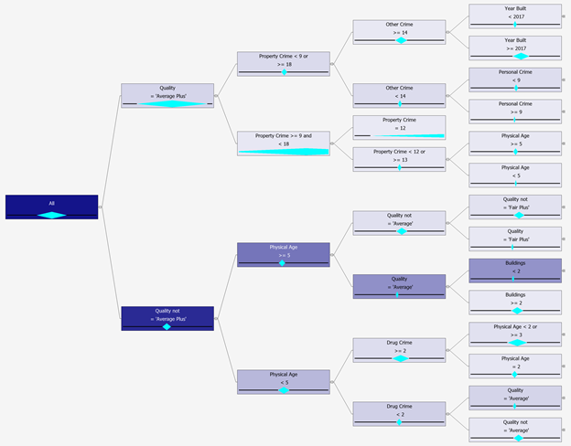
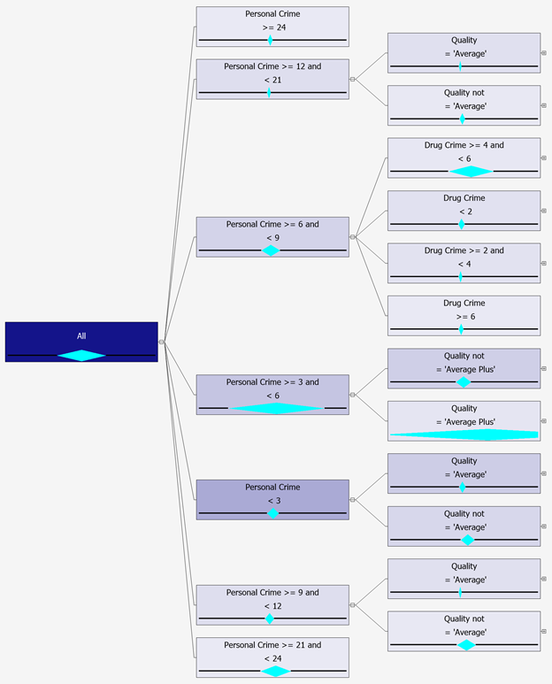
Decision Tree
Binary Split
Combined split

Slide 7
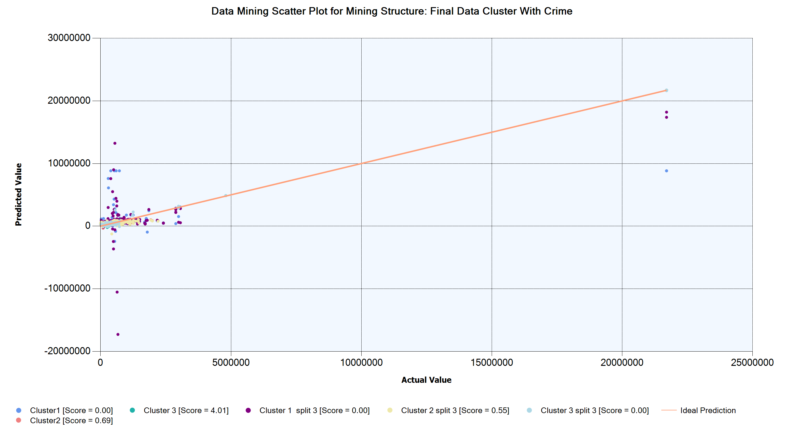
Decision Tree
The model with cluster 1 and cluster 3 combined split has larger residual (score = 0)
Cluster 3 with binary split and cluster 2 have higher accuracy

Slide 8
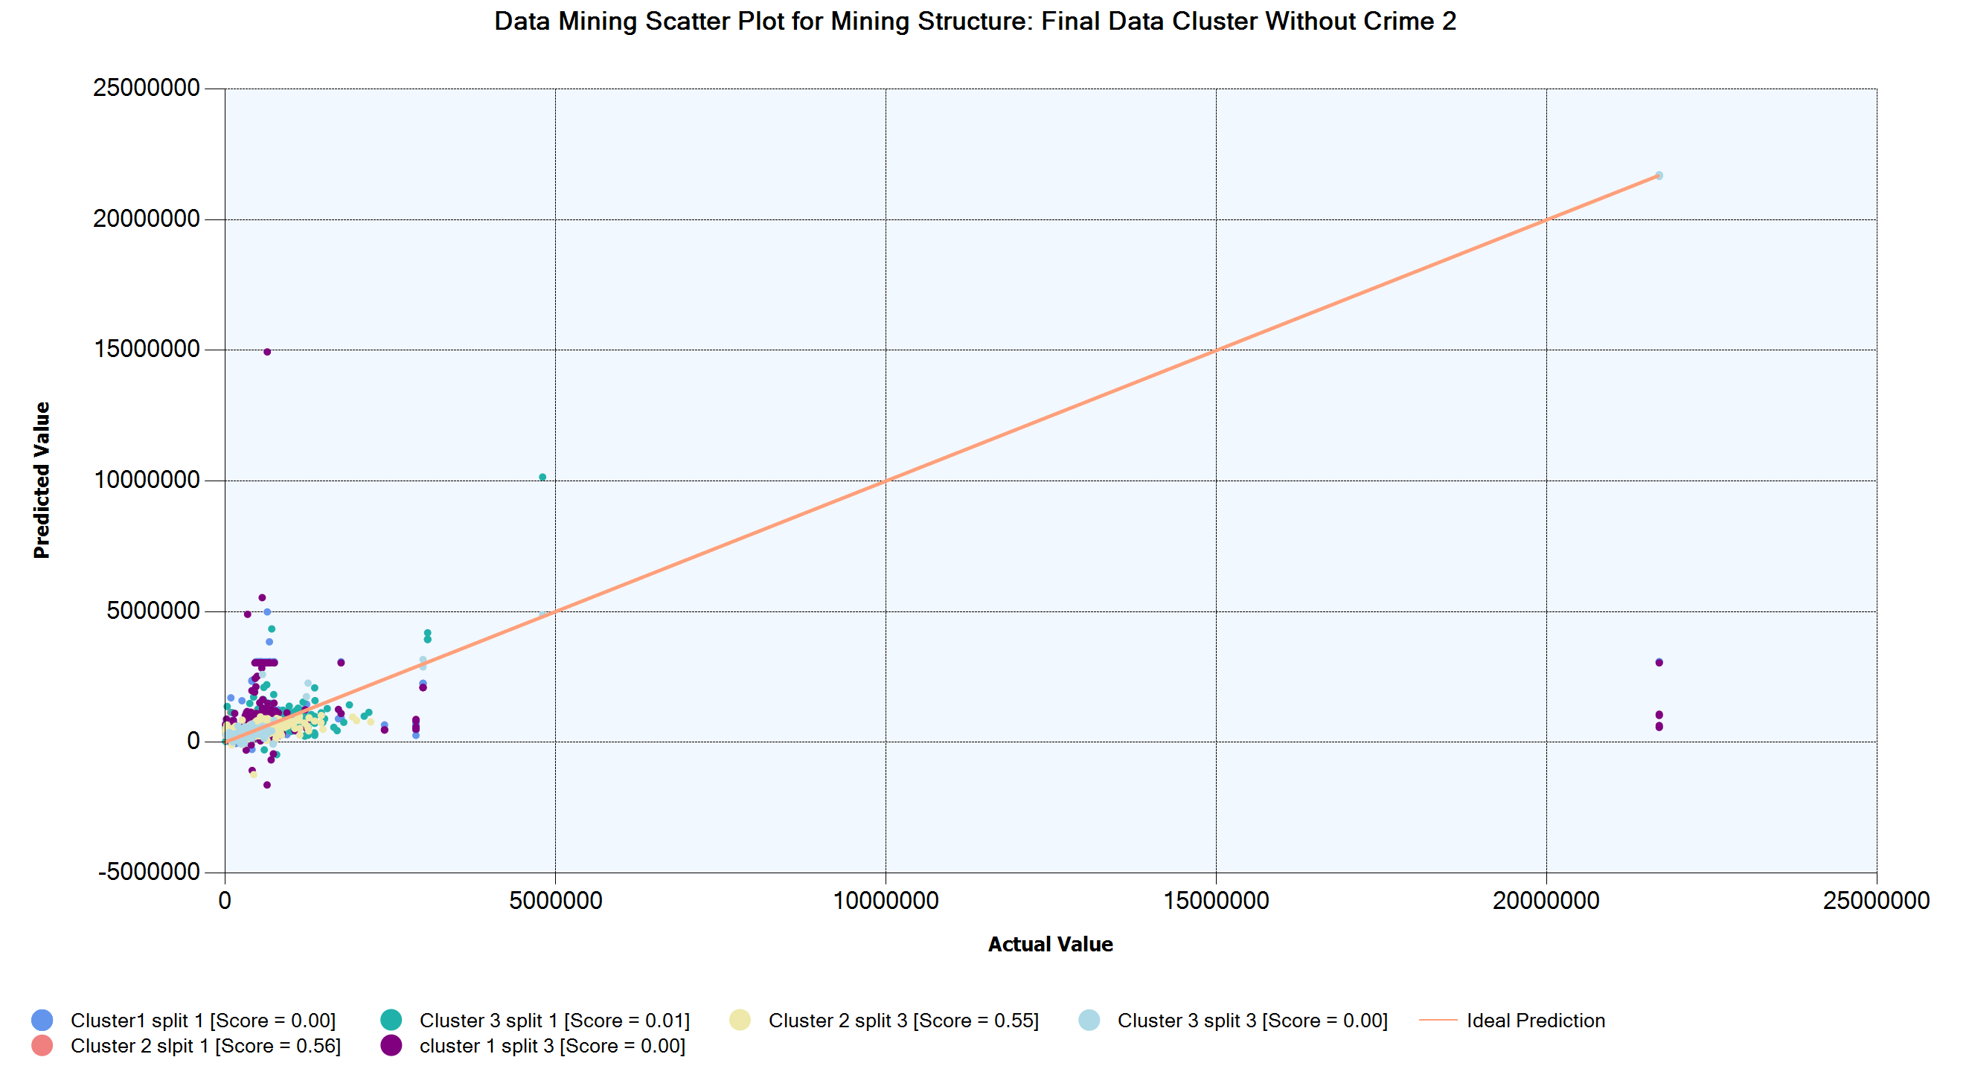
Decision Tree
Cluster 1, and cluster 3 have lowest accuracy
Only cluster 2 has higher accuracy
On average, models with crime attributes can explain the house value more than model with only house attribute

Slide 9
Neural Network
Normalize data​
Using 2 dataset with and without crime data​
Full and Clustered Data
1 hidden layer with 10 nodes​
2 hidden layer with 10 and 15 nodes

Slide 10
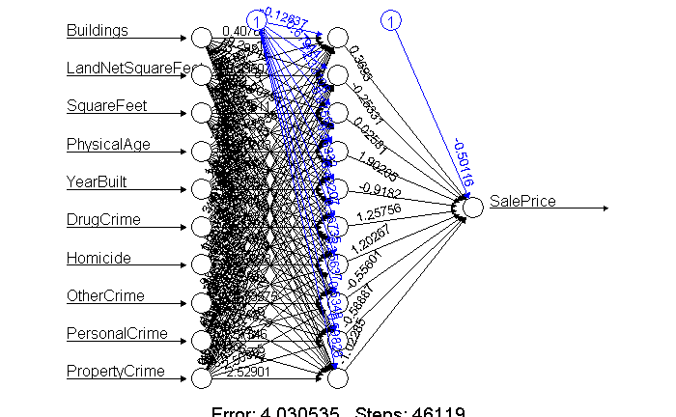
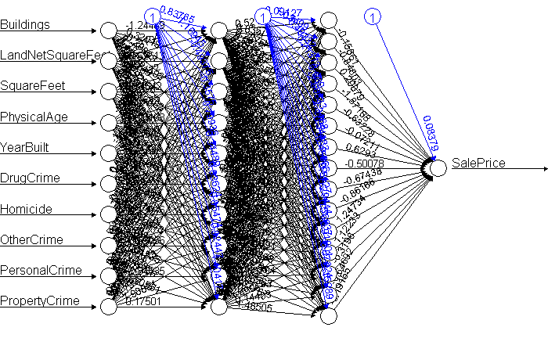
Neural Network
Cluster 1: With Crime Attributes (1 Hidden Layer)
Cluster 1: With Crime Attributes (2 Hidden Layer)

Slide 11
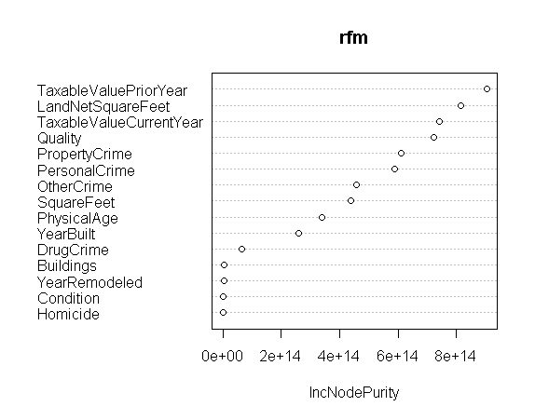
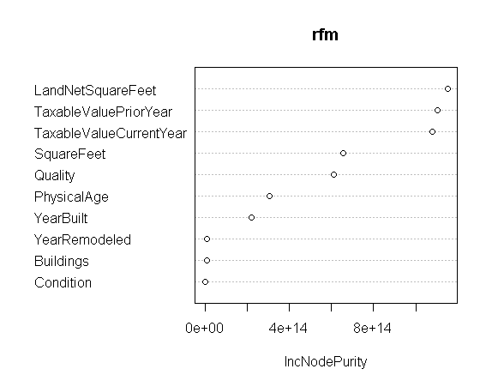
Random Forest
Full Dataset: With Crime Attributes
Full Dataset: Without Crime Attributes

Slide 12
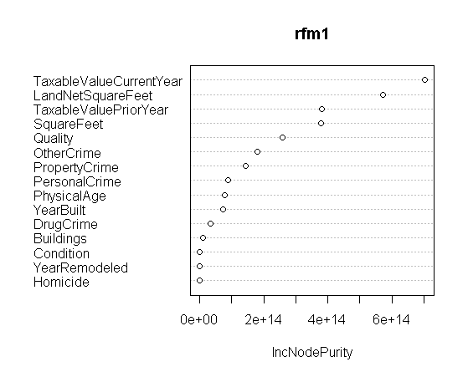
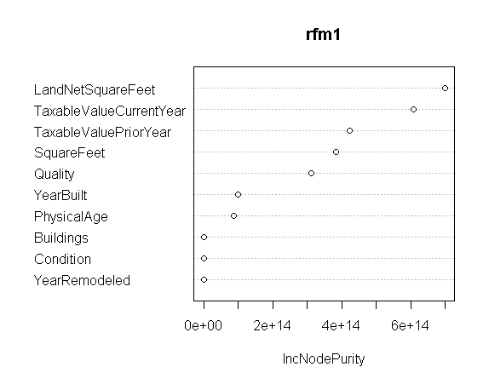
Random Forest
Cluster 1: With Crime Attributes
Cluster 1: Without Crime Attributes

Slide 13
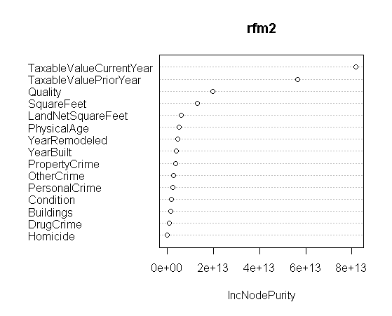
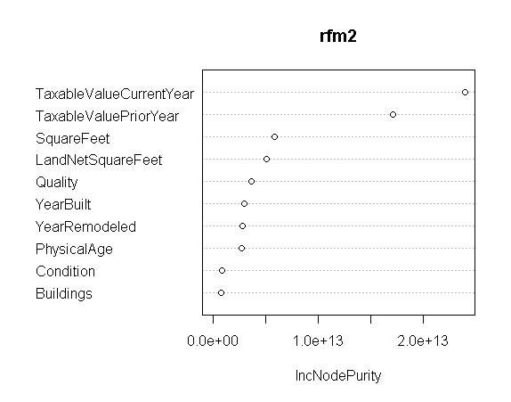
Random Forest
Cluster 2: With Crime Attributes
Cluster 2: Without Crime Attributes

Slide 14
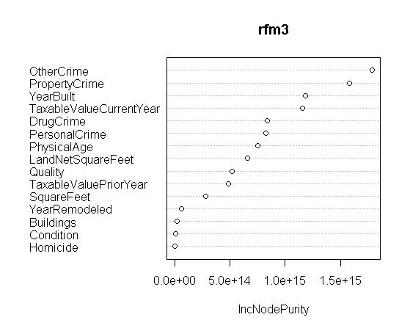
Random Forest
Cluster 3 with crime attributes
First instance where crime showed more significance than house attribute
Cluster 3 had significantly had more crime observations

Slide 15
Model Evaluation
Decision Tree |  | With Crime |  |  |  | Without Crime
 |  | Full | Cluster 1 | Cluster 2 | Cluster 3 | Full | Cluster 1 | Cluster 2 | Cluster 3
MSE | Binary Split | 802,791 | 760,370 | 151,577 | 1,090,287 | 1,191,100 | 822,770 | 103,862 | 2,283,599
MAE |  | 140,862 | 139,524 | 87,607 | 246,482 | 157,959 | 139,941 | 61,992 | 593,919
RMSE | Combined Split | 808,843 | 716,590 | 153,184 | 1,313,918 | 1,217,505 | 844,002 | 102,695 | 2,771,435
MAE |  | 146,382 | 155,479 | 88,808 | 278,539 | 177,539 | 158,148 | 61,560 | 788,747

Slide 16
Model Evaluation
Neural Network |  | With Crime |  |  |  | Without Crime
 |  | Full | Cluster 1 | Cluster 2 | Cluster 3 | Full | Cluster 1 | Cluster 2 | Cluster 3
RMSE | 10 Nodes | 942,523 | 1,009,950 | 382,911 | 1,310,449 | 446,063 | 1,013,235 | 307,147 | 1,524,744
MAE |  | 159,348 | 232,421 | 334,709 | 194,418 | 427,282 | 174,120 | 283,337 | 342,764
RMSE | 10 and 15 Nodes (hidden layer) | 942,523 | 1,009,950 | 382,939 | 1,086,080 | 446,550 | 1,010,770 | 307,165 | 1,641,107
MAE |  | 140,083 | 201,409 | 334,562 | 162,899 | 429,833 | 174,433 | 283,255 | 348,074

Slide 17
Model Evaluation
Random Forest | With Crime |  |  |  | Without Crime
 | Full | Cluster 1 | Cluster 2 | Cluster 3 | Full | Cluster 1 | Cluster 2 | Cluster 3
RMSE | 383,215 | 935,123 | 85,499 | 1,039,295 | 707,119 | 872,753 | 88,143 | 1,298,972
MAE | 75,139 | 124,167 | 51,584 | 130,690 | 102,167 | 126,689 | 47,404 | 203,945
% Var Explained | 68.64 | 21.45 | 78.41 | 67.41 | 49.92 | 16.52 | 57.88 | 55.74

Slide 18
Results & Findings
Full vs Clustered Datasets reported similar results in terms of their performance
Integrating crime attributes provides lower error scores than excluding crime attributes
Random Forest model provided the most statistically significant results. In both models (With and Without Crime), Cluster 2 overall had the lowest RMSE and MAE values. Both models only had minor differences in the RMSE and MAE values
Cluster 3 had more crime observations, and the decrease in the RMSE and MAE values could be explained by the addition of the crime attributes to the With Crime model
Crime does have a significant effect on the property values in Pierce County

Slide 19
Interpretation & Implication of Results
Local governments can use these findings in order to invest more resources into stopping the types of crimes that have the biggest negative impact on the property values
Investors can use the results to make important decisions on housing development locations that would maximize their future profits

Slide 20
Limitations
Currently, integrating 100% house data and crime data is impossible.
10% of crime does not reflect the whole effect of crime on house value.
Impact of actual vs. perceived crime
Sales price vs. market value

Slide 21
Recommendations & Moving Forward
Figure out a way to measure crime severity
Integrate crime frequency
Divide data into groups based on geographic attribute like city for analysis
Integrate market value as another attribute
Encourage other local governments (counties) to collect and publicize similar data as Pierce County
Replicate this research and adapt it fit their respective needs

Slide 22
Thank YOU!

